Slide 1
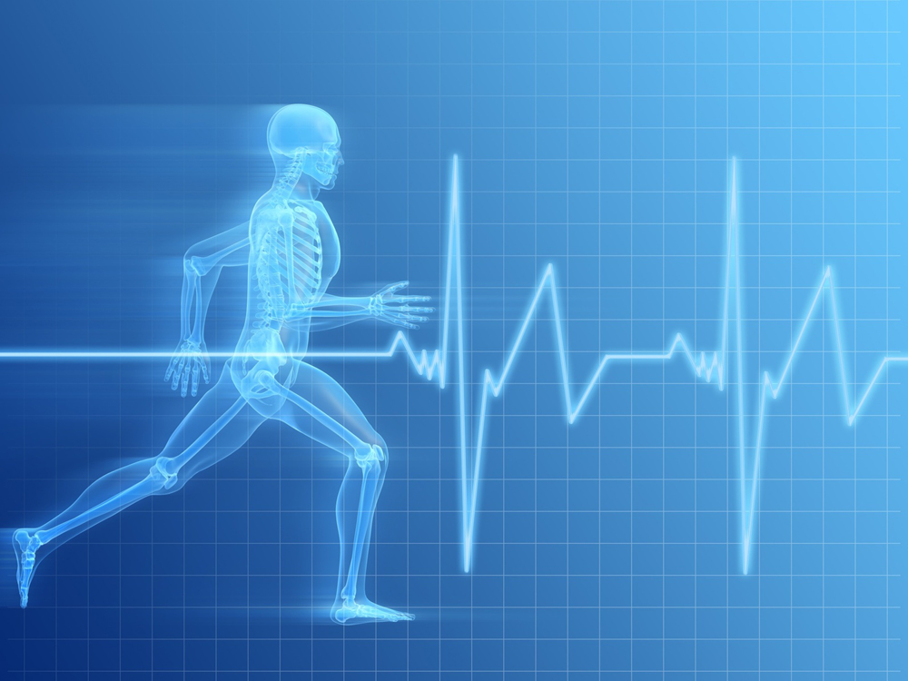
Health Check
Getting Coffee

Slide 2
Health Check
Getting Healthy

Slide 3
How Do We Grow Healthy Spiritually?
Try harder
Think Differently
Suffer
Find a routine we are comfortable with
Read the Bible more
Pray
Practice Spiritual Disciplines

Slide 4
How Do We Grow Spiritually?
Stage Theory
  Conversion
  Large Group Growth
  Service
  Deep Questions
  The Wall
  Freedom
  (adapted from books like critical journey)

Slide 5

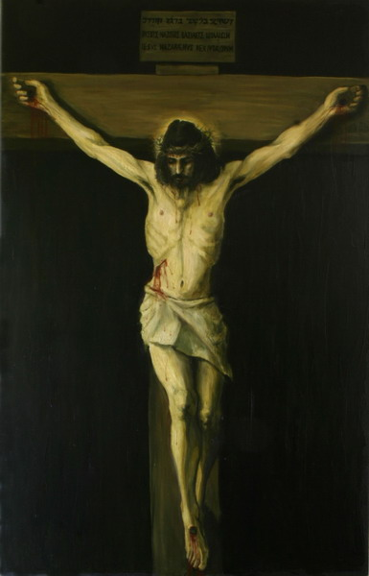
The Role of Suffering in Health
Sears Stage Theory
  Suffering as punishment
  Suffering as discipline
  Vicarious Suffering

Slide 6
Vicarious Suffering
Finally, with the gift of the Holy Spirit at Pentecost, the full, universal implications of Jesus' death were made manifest. Now the message was to be given not only to fellow believers but to the whole world (Mt. 28:19). …I call this "mission" faith. The mission is to reveal God's love for God's sake, as Jesus did in his passion and death (Jn. 14:31)-to be a "witness" or "martyr."
  (Sears)

Slide 7
Being Jesus:
Slum Outreach in Malaybalay
We were still reeling from what we had seen during our visits to the community. The suffering is real. The poverty is real. It wasn’t out-of-sight, out-of-mind from our comfortable life back home any-more. This is why we came here, I kept thinking.
So, we prayed! And God not only gave us an answer for working at Isla Bonita, he gave us a vision for our whole mission: The idea boils down to imitating Christ. For the first 30 or so years of His life, Jesus lived and worked among the people of Nazareth. He did what they did, ate what they ate, and lived how they lived. He cared about them and befriended them. He prayed with them and shared life with them. He shared in their sorrows, their struggles, and their joys. He was truly one of them…one of us. We feel convicted to imitate Jesus at Isla Bonita, becoming their friends, forming authentic relationships with people based on faith and friendship. Please pray for us!”

Slide 8

A Word From Willow
Church activity IS NOT a blueprint for spiritual growth.
A person’s love of God and love of others increases along a SPIRITUAL CONTINUUM defined by their relationship with Christ.
KEY CATALYSTS trigger movement along the continuum.
Churches that know how their people stack up against these catalysts have a CLEAR ROADMAP to guide their spiritual growth.

Slide 9
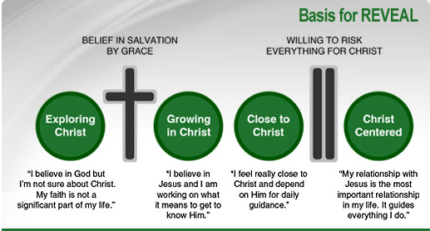
http://www.revealnow.com/

Slide 10
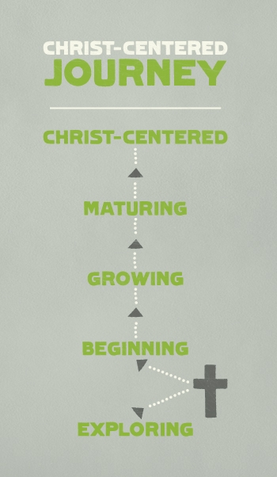
lifepointchurch.org

Slide 11
Group Size And Health

Slide 12
Questions
If you were to measure your health by the stage theories, how would you describe your health?
How have you tried to grow healthy spiritually?
How much is stage theory descriptive and how is it proscriptive (i.e. can knowing stage theory increase health)?

Slide 13

Worldview Formation
Romans 12:2
  Be transformed by the renewing of your mind

Slide 14
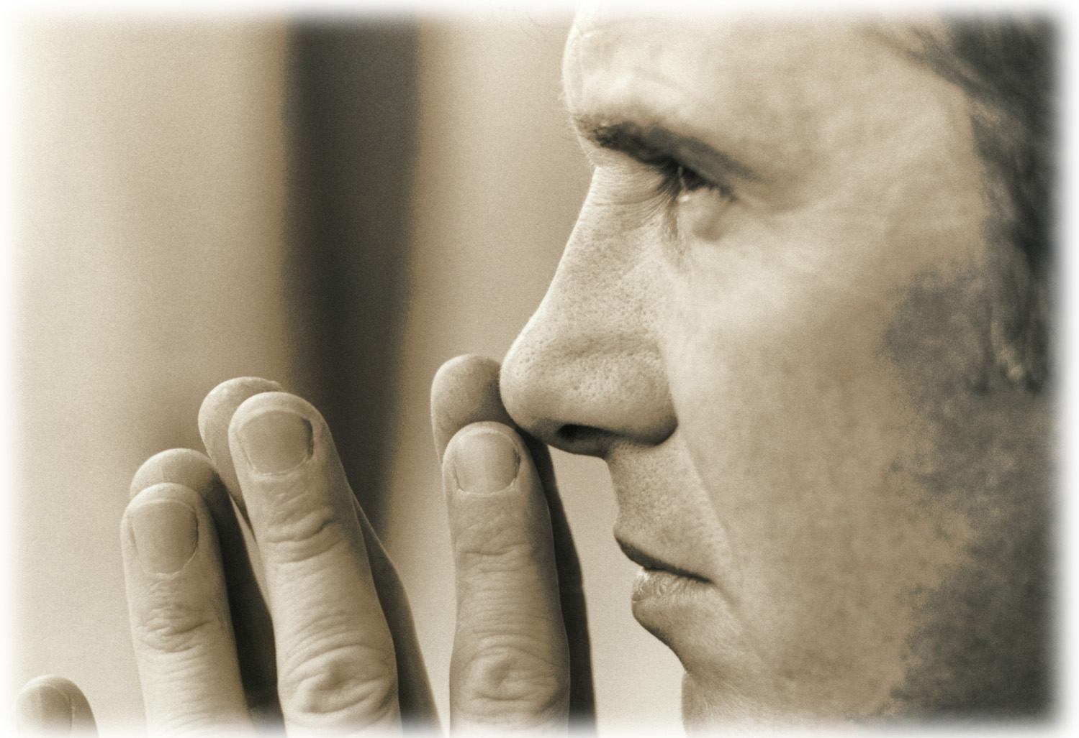
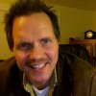
Keith Bjorge
Change my feelings or change my thinking?

Slide 15
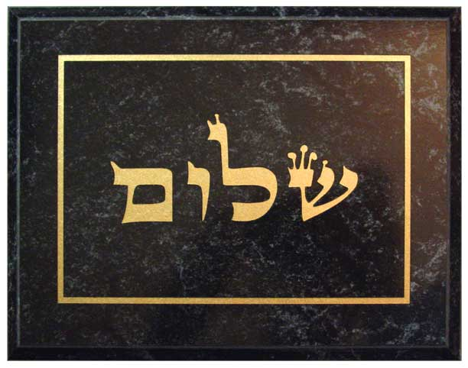
Worldview Narrative
Harmony
  World created in Shalom

Slide 16
GOD

Slide 17
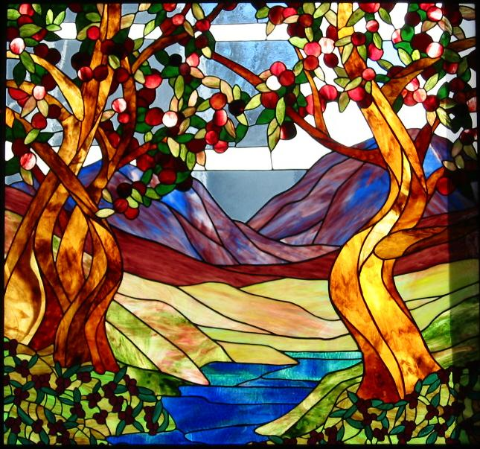
CREATION

Slide 18
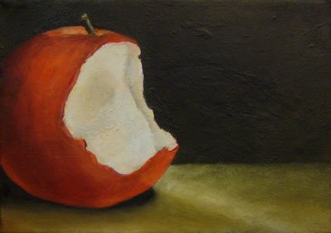
FALL

Slide 19
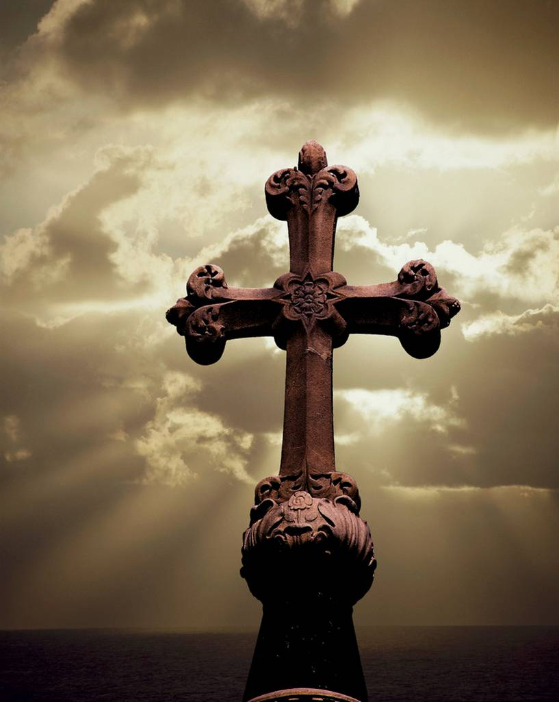
Redemption

Slide 20

Kingdom of God

Slide 21


Slide 22
As You Like It
All the world's a stage,
And all the men and women merely players:
They have their exits and their entrances;
And one man in his time plays many parts
(Shakespeare)

Slide 23
Questions
Am I in harmony with God’s story?
Do I study God’s story to fine tune my shalom?
Do I hold myself accountable to shalom?

Slide 24
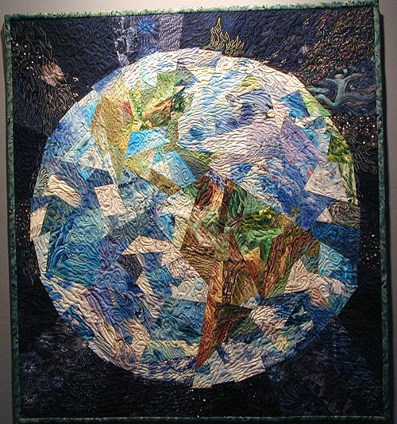
Worldview Beliefs
Which beliefs truly define us?
Which beliefs do we shape our lives around?

Slide 25
What Thoughts Count?
Thoughts about a supreme being or force
Thoughts about human nature and human origins and destiny
Thoughts about what truly exists
Thoughts about what I can know
Thoughts about what makes a good argument
Thoughts about values

Slide 26
Technical Terms
Theology (thoughts about a supreme being or force)
Anthropology (thoughts about human nature and human origins and destiny)
Ontology/Metaphysics (thoughts about what truly exists)
Epistemology (thoughts about what I can know)
Logic (thoughts about what makes a reasonable argument)
Axiology (thoughts and values)

Slide 27


Slide 28
Worldview Questions
What do you value the most?
What books, people, or electronic media inform your life?
Do you believe that human beings are good, evil, or neither?
Is there such a thing as truth?
What, if anything, happens to people when they die?
Is there a physical world, a spirit world, or neither?
Is there a supreme force, power, or being? Can you describe your idea?
Is logic to be trusted?

Slide 29

Professed Beliefs

Slide 30
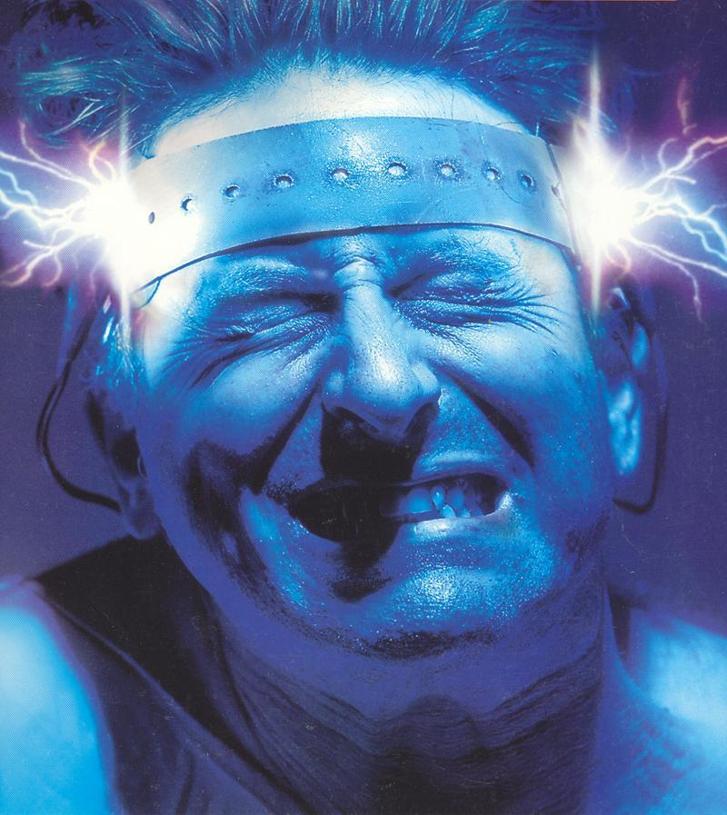
Controlling Beliefs

Slide 31
Worldview Questions
What do you value the most?
What books, people, or electronic media inform your life?
Do you believe that human beings are good, evil, or neither?
Is there such a thing as truth?
What, if anything, happens to people when they die?
Is there a physical world, a spirit world, or neither?
Is there a supreme force, power, or being? Can you describe your idea?
Is logic to be trusted?

Slide 32

Christian Smith
Post Christian
Moralistic
Therapeutic
Deism

Slide 33
Moralistic Therapeutic Deism
As described by Smith and his team, Moralistic Therapeutic Deism consists of beliefs like these: 1. "A god exists who created and ordered the world and watches over human life on earth." 2. "God wants people to be good, nice, and fair to each other, as taught in the Bible and by most world religions." 3. "The central goal of life is to be happy and to feel good about oneself." 4. "God does not need to be particularly involved in one's life except when God is needed to resolve a problem." 5. "Good people go to heaven when they die."
That, in sum, is the creed to which much adolescent faith can be reduced. After conducting more than 3,000 interviews with American adolescents, the researchers reported that, when it came to the most crucial questions of faith and beliefs, many adolescents responded with a shrug and "whatever."
Read more at http://www.christianpost.com/news/moralistic-therapeutic-deism-the-new-american-religion-6266/#bUZWR9MYVZCfojC7.99

Slide 34

How Do I Develop A Christian Worldview?
Thoughts about God
  From the Bible
  From community
  From preaching
Beliefs – Values – Actions
Actions – Values – Beliefs

Slide 35

Next Steps
How do the following play into your plans to grow healthy spiritually?
  Stage Theory
  Group Size
  Shalom
  Worldview
  Bible Reading
  Prayer
  Other

