Slide 1
Health Check
Catching a Worldview

Slide 2

What movies have you seen recently?
Rank these movies from best to worst:
  Dark Knight Rising
  Casablanca
  Finding Nemo
  Hunger Games
In your group discuss what makes a good movie?
How did you evaluate what is good and what is bad?

Slide 3
What does Jesus have to do with movies?
When we rank things or rate them from good to bad, we appeal to a standard.
Why doesn’t Jesus’ opinion figure in our thinking?

Slide 4
Why doesn’t Jesus’ opinion figure?
Jesus didn’t go to the movies.
We don’t want to spiritualize.
We don’t want to be ‘holier-than-thou’.
Good and bad are subjective matters of taste.

Slide 5
Jesus didn’t go to the movies.
Because things aren’t listed specifically in scripture we need not bring them to Jesus.
The Koran and Hadith try and legislate for every area of life, but the Bible teaches principles.
What are the key principles of the Bible?

Slide 6
What are the Bible’s key principles?
Love God with all your heart, soul, mind and strength (shema and Jesus’ opinion).
Love your neighbour as yourself.

Slide 7
How does the greatest commandment apply to the movies?
Which movies help me love God and my neighbour?
Which movies estrange me from God and my neighbour?
Can’t a movie be neutral and just entertainment?

Slide 8
Can’t a movie be just entertainment?
Entertainment as ‘amusement’?
Entertainment as ‘engagement’?
If Jesus was entertaining, in what way was that?

Slide 9
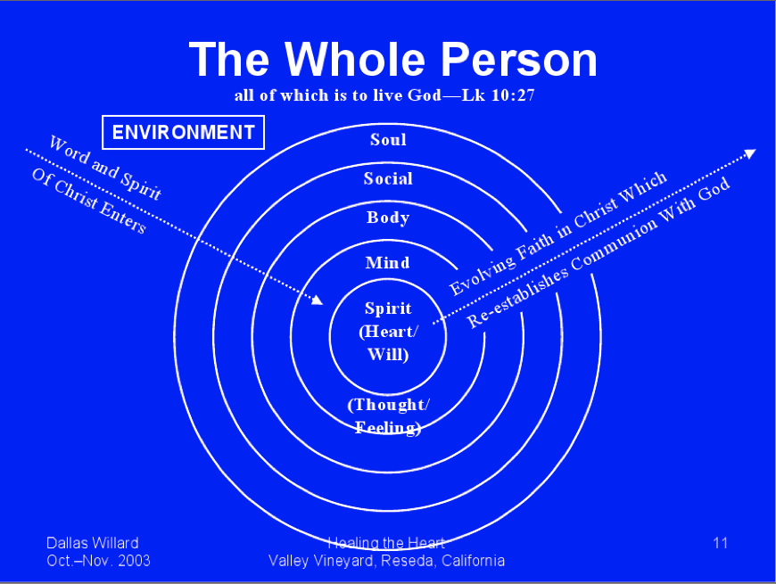
Dallas Willard and Matthew 5

Slide 10
Everything is permissible …
Stands against legalism.
I am a better or worse person for watching a movie.
“How far can I go … ?” – As far as your heart will let you.
1 Corinthians 10:23

Slide 11

…but not everything is beneficial.
Not everything is constructive.
What are we constructing?
What are our lives about?

Slide 12
Evaluating your movie selection
What are the values espoused in chick flicks?
What do most movies say about God?

Slide 13

The Hidden Curriculum
‘Hidden’ curriculum is the content that we communicate around our main message. In movies it is the music, the tone, or the commentary.
  Jesus Camp (music)
  Saved (tone)
  David Atenborough

Slide 14
The Null Curriculum
‘Null’ curriculum is the absence of content.
  Cars 2 says nothing about God
  Most movies make no mention of God
  What does saying nothing about God in our most popular stories teach us?

Slide 15

Who Indoctrinated Us As Children?
An overview of cultural influences and what to do to address them

Slide 16
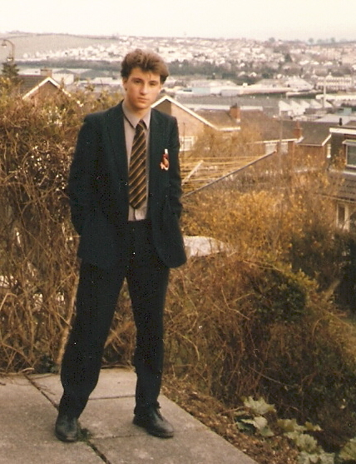
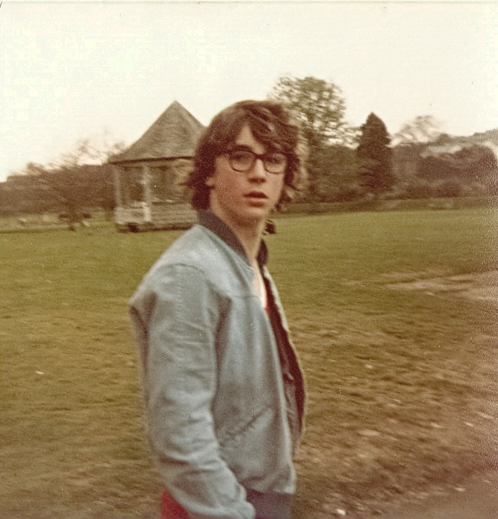
A Personal Exercise In Conflicted Worldview

Slide 17
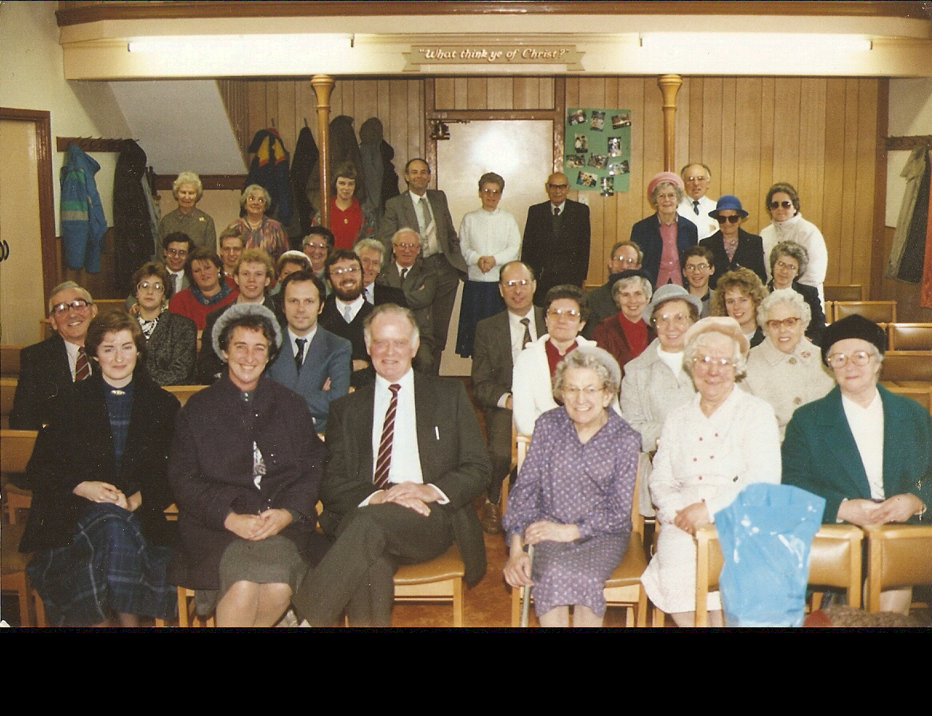
Saved

Slide 18


Informal Surveys of Christian Children
Theology is morphed
Values are morphed
People are good
Hell is absent
Assertion is arrogant
Balance is everything

Slide 19
Formal Surveys of Christian Children
Biblical inerrancy is abandoned by children in Junior High (Barna)
Children are walking away from God in college and probably not coming back (Barna)
children of all major religions are developing a similar worldview (Smith)

Slide 20



How Did Christian Worldview Dissolve?
Constructivist Classrooms

Slide 21
Constructivism
Social constructivism is based on specific assumptions about reality, knowledge, and learning. To understand and apply models of instruction that are rooted in the perspectives of social constructivists, it is important to know the premises that underlie them.
Reality: Social constructivists believe that reality is constructed through human activity. Members of a society together invent the properties of the world (Kukla, 2000). For the social constructivist, reality cannot be discovered: it does not exist prior to its social invention.
Knowledge: To social constructivists, knowledge is also a human product, and is socially and culturally constructed (Ernest, 1999; Gredler, 1997; Prat & Floden, 1994). Individuals create meaning through their interactions with each other and with the environment they live in.
Learning: Social constructivists view learning as a social process. It does not take place only within an individual, nor is it a passive development of behaviors that are shaped by external forces (McMahon, 1997). Meaningful learning occurs when individuals are engaged in social activities.
(Beaumie Kim, University of Georgia)

Slide 22


How Did Christian Worldview Dissolve?
Existential Movies

Slide 23

Existentialism
A journey
Choice
Angst
Self-actualization
Experience
Meaning in absurdity

Slide 24


How Did Christian Worldview Dissolve?
Hedonistic Peer Groups

Slide 25
Hedonism
Pleasure is the measure
Happiness
Therapeutic
Comfort
“I just want my kids to be happy”

Slide 26

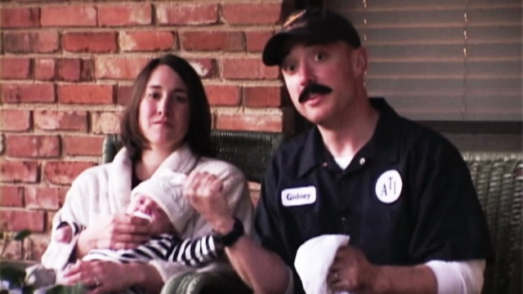

How Did Christian Worldview Dissolve?
Consumerist Churches
http://video.google.com/videoplay?docid=1871627498681344879#

Slide 27
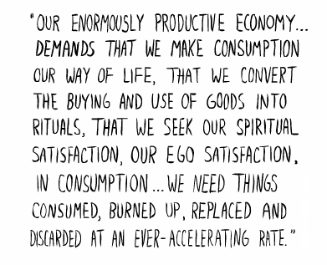
Consumerism
The customer is always right
Shopping
Economic engines
The method is the message
An imminent world
An immediate world

Slide 28

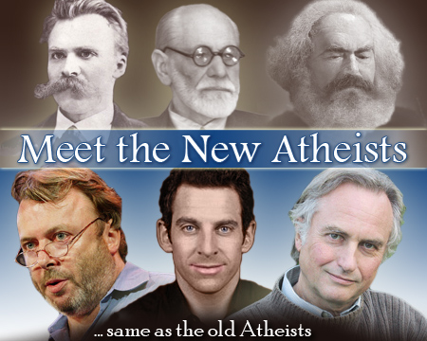
How Did Christian Worldview Dissolve?
New Atheist Scientism Debate

Slide 29
Scientism
All epistemology is scientific
Science develops a great story (metanarrative)
All opponents are intellectually deficient
Scientism/Humanism/Naturalism/Materialism

Slide 30


How Did Christian Worldview Dissolve?
Secular Homes

Slide 31
Secularism
There are secular and sacred worlds
There are Christian and Non-Christian worlds
There are Private and Public Worlds
Religion is permitted, but has limited public value
Sunday vs. Week
Religion is irrelevant
Practical Atheism

Slide 32




Who Are Our Children?
Postmodern
Post Christian
Post Secular
Post-Covenantal
Postal

Slide 33

Who’s Indoctrinating Our Children?
Venue
Worldview
School
Media
Friends/Peers
Church
Authority Figures
Homes/Parents
Constructivism
Hedonism
Secularism
Humanism
Postmodernism
Buddhism
Islam
New Age

Slide 34


What is a Worldview?
A story that explains all reality and to which people conform

Slide 35

What is Worldview?
Weltanschauung
  “a comprehensive conception or apprehension of the world especially from a specific standpoint” (Webster)

Slide 36

Worldview Questions
What do you value the most?
What books, people, or electronic media inform your life?
Do you believe that human beings are good, evil, or neither?
Is there such a thing as truth?
What, if anything, happens to people when they die?
Is there a physical world, a spirit world, or neither?
Is there a supreme force, power, or being? Can you describe your idea?
Is logic to be trusted?

Slide 37

Worldview Formation
From the macro to the micro
From Biblical Theology to the verses
From the largest context to my life

Slide 38



Worldview Formation
New Tribes Curriculum

Slide 39

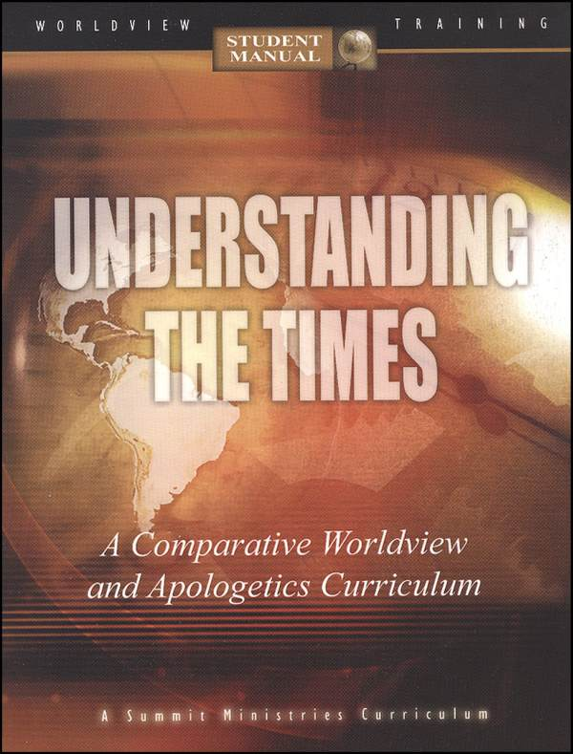
Worldview Formation
Summit Ministries Curriculum

Slide 40
Worldview Formation
How can 30 hours per week of secular humanist schooling be undone in 2 hours by children’s ministry?
How are most parents in the church indoctrinating their children?
What is the role of catechesis and why is it unpopular?
What do children abandoning the faith in our neighborhood embrace?

Slide 41
Worldview Formation
What do the most popular children’s movies teach as they come out?
Are our children to be sheltered so that their innocence is preserved?
Should we have a viable alternative to the public school?
How is Christian education most effective?

Slide 42
Worldview Formation
Are we covering biblical truth or communicating biblical truth?
If I evaluate the children that I know by their actions, what beliefs drive their actions?
Around what concepts or images do the children I know shape their lives?
How much should the church engage trends like emo, sk8er punk, goth, etc.?

Slide 43

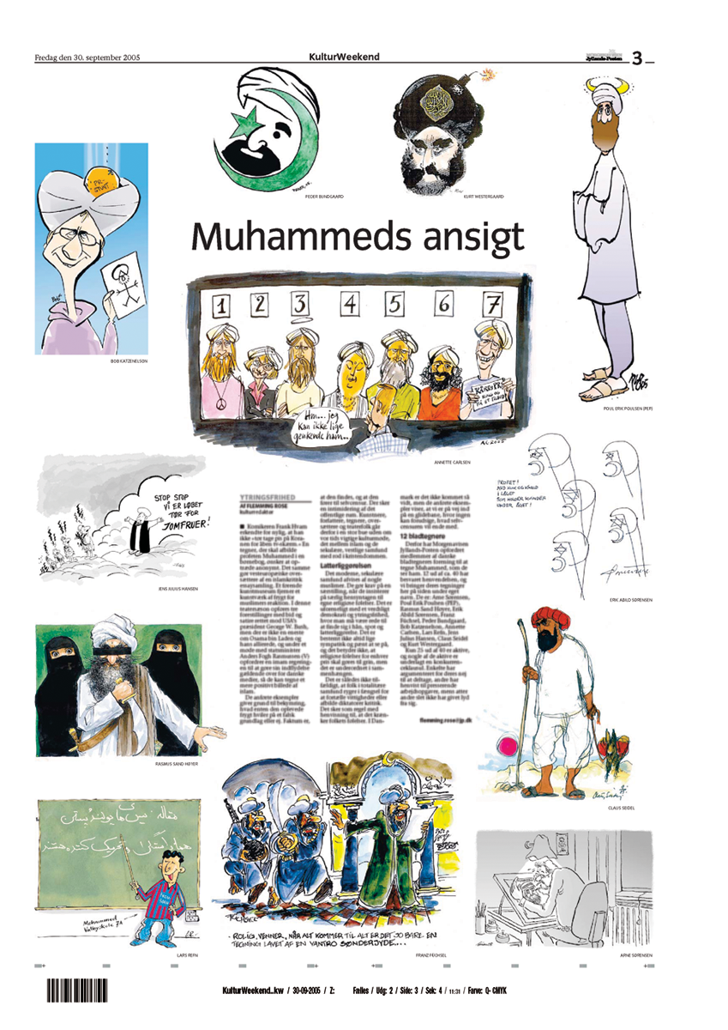

Where is the world headed?

Slide 44

Where is the world headed?

Slide 45
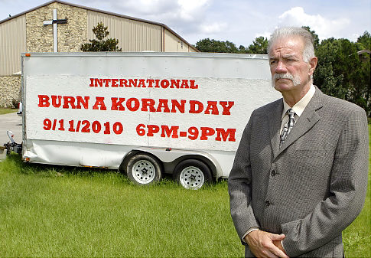
Where is the world headed?
The White House on Monday slammed Koran burning as "un-American" but said a US pastor's destruction of the Muslim holy book did not justify the killings of UN personnel in Afghanistan.
(AFP, April 4th, 2011)

Slide 46

Neo-nationalism
Counter globalization
Counter terrorism
Counter relativism

Slide 47

Transmodernism
Synthesis
Classical + Modern + Postmodern
Pessimism, nihilism, relativism are out
Optimism, absolutism, foundationalism are in

Slide 48
Postsecularism
New Age Spirituality
  "Without the ultrarational hopes and passions of religion no society will ever have the courage to conquer despair and attempt the impossible; for the vision of a just society is an impossible one, which can be approximated only by those who do not regard it as impossible."--Reinhold Niebuhr

Slide 49
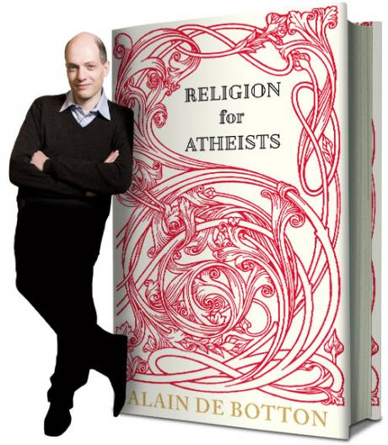
Religion For Atheists

Slide 50
Religion For Atheists
What if religions are neither all true nor all nonsense? The long-running and often boring debate between fundamentalist believers and non-believers is finally moved forward by Alain de Botton’s inspiring new book, which boldly argues that the supernatural claims of religion are entirely false—but that it still has some very important things to teach the secular world.
Religion for Atheists suggests that rather than mocking religion, agnostics and atheists should instead steal from it—because the world’s religions are packed with good ideas on how we might live and arrange our societies. Blending deep respect with total impiety, de Botton (a non-believer himself) proposes that we look to religion for insights into how to, among other concerns, build a sense of community, make our relationships last, overcome feelings of envy and inadequacy, inspire travel and reconnect with the natural world.
For too long non-believers have faced a stark choice between either swallowing some peculiar doctrines or doing away with a range of consoling and beautiful rituals and ideas. At last, in Religion for Atheists, Alain de Botton has fashioned a far more interesting and truly helpful alternative. (Amazon)

Slide 51

Kingdom of God
Each child sees themselves as a player in God’s story.
Each child sees their vocation as divinely appointed.
Each child sees God as the source of their curriculum.
Each child lives differently from others (in public and private life) as they daily realise the image of Christ.

Slide 52
David Kinnaman of Barna
"Churches, organizations and families owe this generation more. They should be treated as the intelligent, capable individuals they are—a generation with a God-given destiny. Renewed commitment is required to rethink and realign disciple-making in this new context. Mosaic believers need better, deeper relationships with other adult Christians. They require a more holistic understanding of their vocation and calling in life—how their faith influences what they do with their lives, from Monday through Saturday. And they also need help discerning Jesus' leading in their life, including greater commitment to knowing and living the truth of Scripture."

Slide 53
Movie Questions
Why do people make movies?
What do the stories in movies teach us?
What is left out of the movies?
How do movies affect our health?
How are movies rated for content? How is that relevant or irrelevant for a Christian?
Brian Godawa wrote an award-winning Christian horror movie (Cruel Logic). Is that allowed?

Slide 54
We’ve Been Indoctrinated

