Slide 1
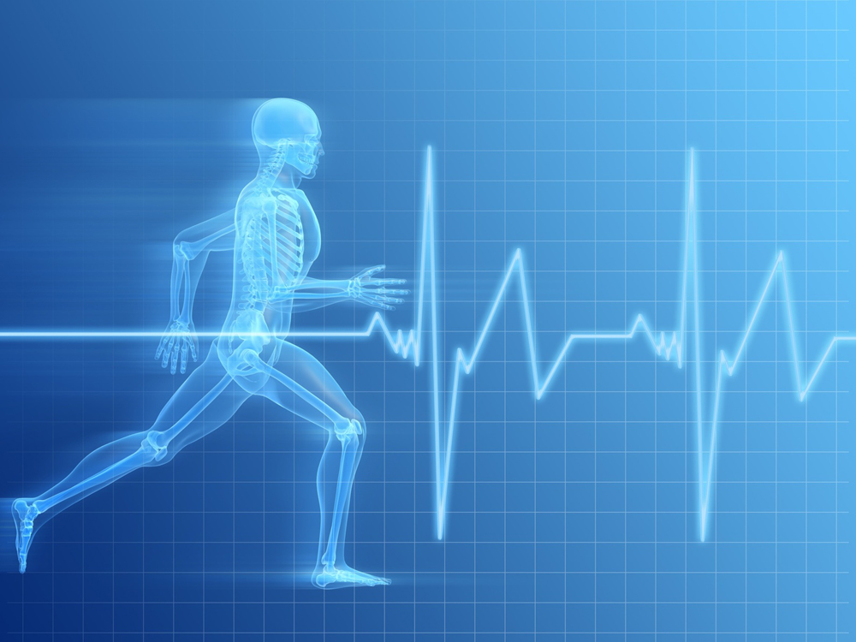
Health Check
Misconceptions

Slide 2
How Are You Doing?
What experiences stand out for you in 2012?
How is your physical health? How does that affect other things?
How is your emotional health? How is that related to other things?
How is your spiritual health?
What makes a healthy Christian?

Slide 3
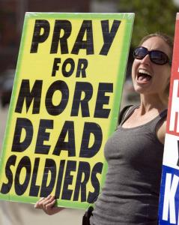

Are Christians Sick?
We will evaluate whether we should take on board some of the accusations those outside the faith make.

Slide 4

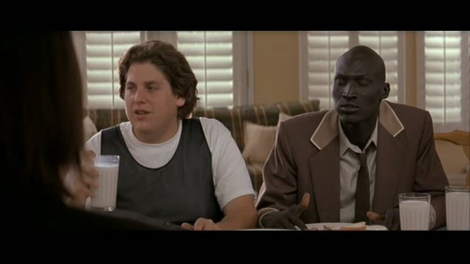
Someone who is socially awkward.

Slide 5
What I Heart Huckabees Teaches
(Questions from I Heart Huckabees)
Christians are sheltered by homeschooling
Christians are socially awkward
Christians are self-righteous because of some good acts that they have done
Christians are married to capitalism
Christians are simplistic and naïve

Slide 6
Christian as Sheltered
In Favour
  Be ye separate from among them (2 Cor. 6:14-18)
  Do not be conformed by the pattern of this world (Rom. 12:2)
Against
  Sons of Issachar (1 Chr. 12:32)
  Salt and light (Matt. 5:13-16)

Slide 7
Christians Are Socially Awkward
For
  Jesus and his parties
    Herod’s party (Luke 23:8-12)
  Diana of the Ephesians (Acts 19)
Against
  Jesus and his parties
    Levi and friends (Matt. 9:9-12)
  Paul in the agora (Acts)

Slide 8
Christians Think Good Acts Make Them Better Than Other People
For
  Ten Commandments (Exodus 20)
  Put on and Put off (Col. 3:5-11)
Against
  Jesus and the Pharisees in the Sermon on the Mount (Matt 5:20)
  Paul and circumcision (castration)
  (Gal. 5: 11-13)

Slide 9
Christians Embrace Capitalism
For
  You don’t work, you don’t eat (2 Thes. 3:10)
  (Proverbs)Working hard has its reward
  Accepts that people are sinful and holds them accountable
Against
  Don’t presume profit (James 4 & 5)
  Care for the poor and needy
  Capitalism is rooted in self-interest

Slide 10
Christian Are Simplistic And Naïve
For
  Be innocent/ignorant of evil (Rom. 16:19)
  Innocent as doves (Matt. 10:16)
Against
  Shrewd as serpents (Matt. 10:16)
  Paul in Athens (Acts 17)

Slide 11
Questions
What laws are the first you think of from the Bible? How do people take them and misuse them?
Should Christians homeschool?
How can a virtuous intent lead to an evil reputation?
Evaluate whether Christians should in some ways be: sheltered; socially awkward; self-righteous

Slide 12
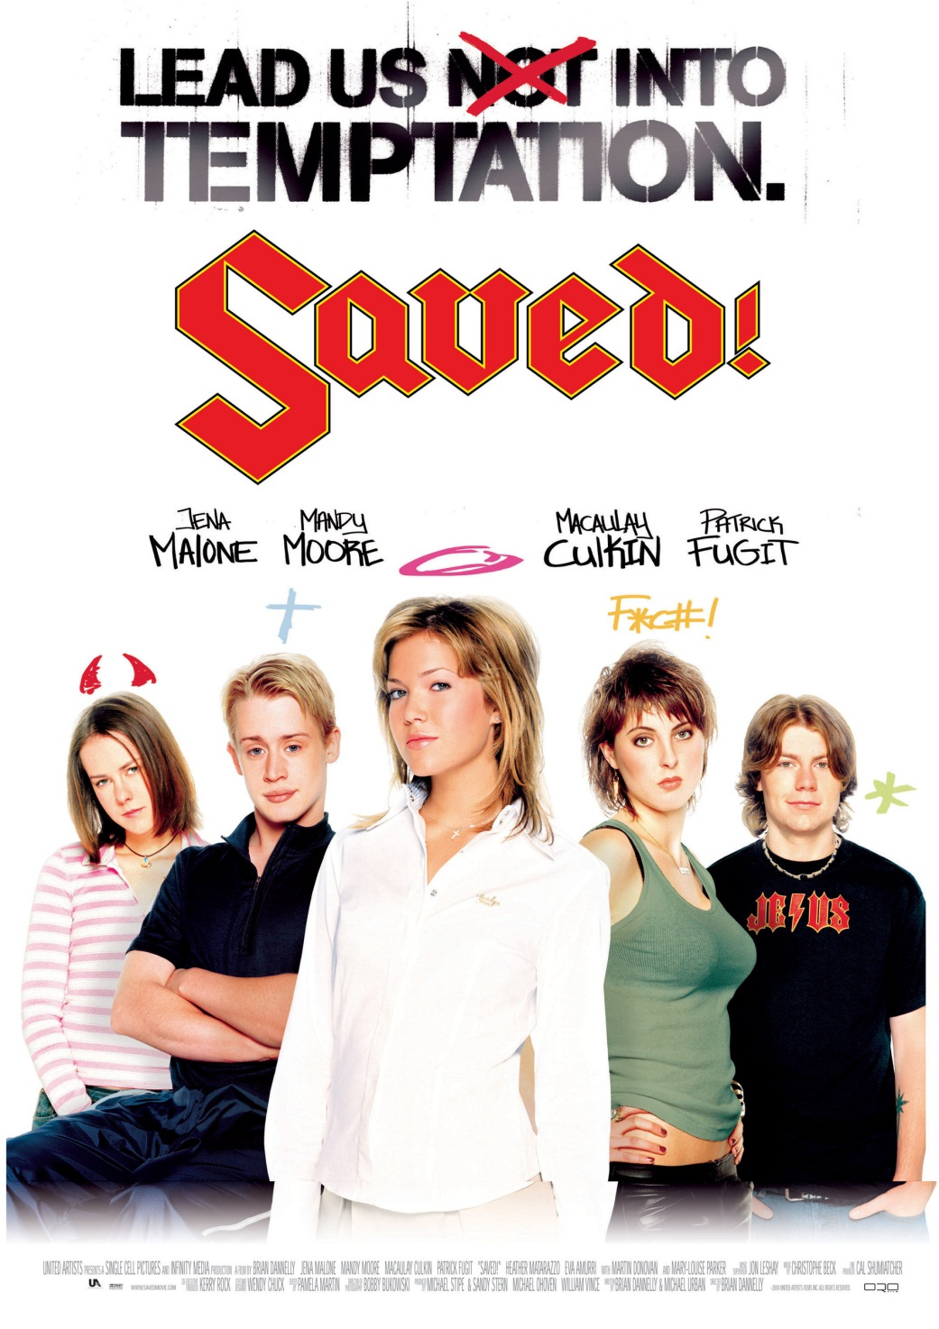

Slide 13
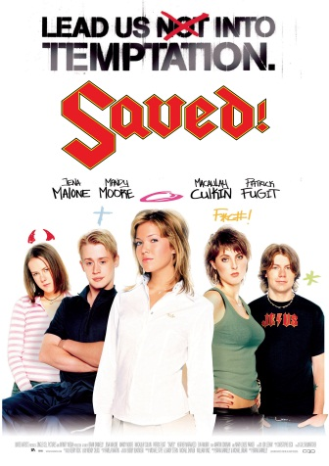
Saved teaches …
Christians are self-seeking
Christians are entertaining.
Christians are the same as everyone else deep down.
Christians are conformist.
Christians are conservative.
Christians are unaccepting.
Christians are obsessed with ‘degayification’.

Slide 14

Christians Are Self-seeking
For
  Following Jesus makes my life better
    Seek ye first … and all these things shall be added unto you. (Matt. 6:33)
    Taste and see that the Lord is good (Psalm 34:8)
    He will give you the desires of your heart (Psalm 37:4)
Against
  1 Corinthians 13
    The way of love is self-sacrificing

Slide 15

Christians Are Entertaining
For
  Jesus attracted crowds with miracles
  Drama was used to communicate simple messages to people like Paul (Acts 21:11)
  Tabernacles, Passover, and The Lord’s Supper
Against
  Is Jesus’ death and resurrection entertaining?

Slide 16

Christians Are The Same As Everyone Else
For
  All have sinned (Romans 1-3)
  Paul and Barnabas fall out over John-Mark
  (Acts 15:36-41)
Against
  Be perfect as the Father is perfect (Matt. 5: 48)
  Let your good works shine before men
  (Matt. 5:16)
  You are a new creation (2 Cor. 5:17)

Slide 17
Christians Are Conforming
For
  Conformed to the image of Christ (Rom. 8:28-31)
Against
  Not after the pattern of this world (Rom 12:2)

Slide 18
Christians Are Socially Conservative
For
  Abortion: Psalm 139
  Same Sex Marriage: Lev. 18:22
Against
  Social Justice: Feeding the poor, helping the oppressed
  Environment: Creation and God’s mandate

Slide 19
Christians Are Unaccepting
For
  Expel the immoral brother (1 Cor. 5:1-13)
Against
  Be reconciled one to another (Matt. 5:23-25)

Slide 20
Christians Obsess On Degayification
For
  Romans 1: Homosexual practice is a marker of social decline
Against
  But over all of these things put on love
  (Col. 3:14)

Slide 21
Questions
Look through this list and ask whether Christians are to be these things or not:
self-seeking; entertaining; the same as everyone else deep down; conformist; conservative; unaccepting; obsessed with ‘degayification’
How did you justify your position?

Slide 22



Slide 23

There Will Be Blood
Christians are false
Christians are ruled by fear
Christians are legalistic
Christians are damning
Christian faith trumps reason

Slide 24
Christians Are False
For
  All things to all men (1 Cor. 9:19-23)
Against
  Jesus is the truth (John 14:6)
  Whatever is true … (Php: 4:8)

Slide 25
Christians Are Fearful
For
  The devil prowls around like a lion looking for someone to devour (1 Pet. 5:8)
  Maybe the world will pollute me
  The fear of the Lord is the beginning of wisdom (Prov. 1:7)
Against
  Perfect love casts out fear
  (1 John 4:18)
  Angels always told the people God was going to use not to be afraid

Slide 26
Christians Are Legalistic
For
  Torah
  Psalm 119
  Sermon on the Mount – Jesus does not abolish the law
  (Matt. 5:17)
Against
  Romans – the law kills
  (2 Cor. 3:6)
  New Moon Festivals?
  (Col. 2:16)

Slide 27
Christians Are Damning
For
  Jesus talks about hell a lot
  (e.g. Mark 9:43-48)
  Jesus calls unbelievers dogs and swine (Matt 7:6)
Against
  Judge not (Jesus and Paul)
  (Matt. 7 + Rom. 2)
  Love always hopes and always perseveres (1 Cor. 13)
  The prodigal (Luke 15:11-32)

Slide 28
Christians Believe Faith Trumps Reason
For
  Now these three remain
  (1 Cor. 13:13)
  Hebrews 11
Against
  Come let us reason together (Isa. 1:18)
  We are transformed by the renewing of our minds
  (Rom. 12:2)

Slide 29
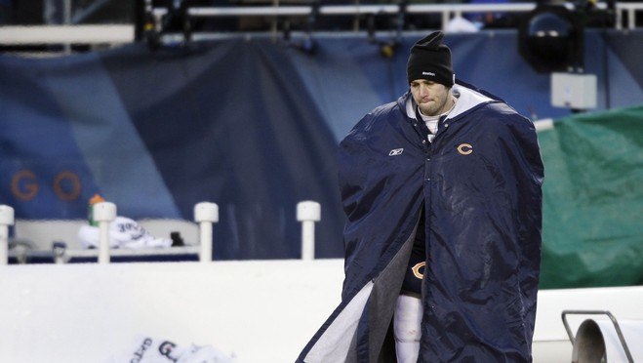
Why Look At How Unhealthy Others Think We are?
When we say we don’t limp and others say we limp, maybe we limp.

Slide 30
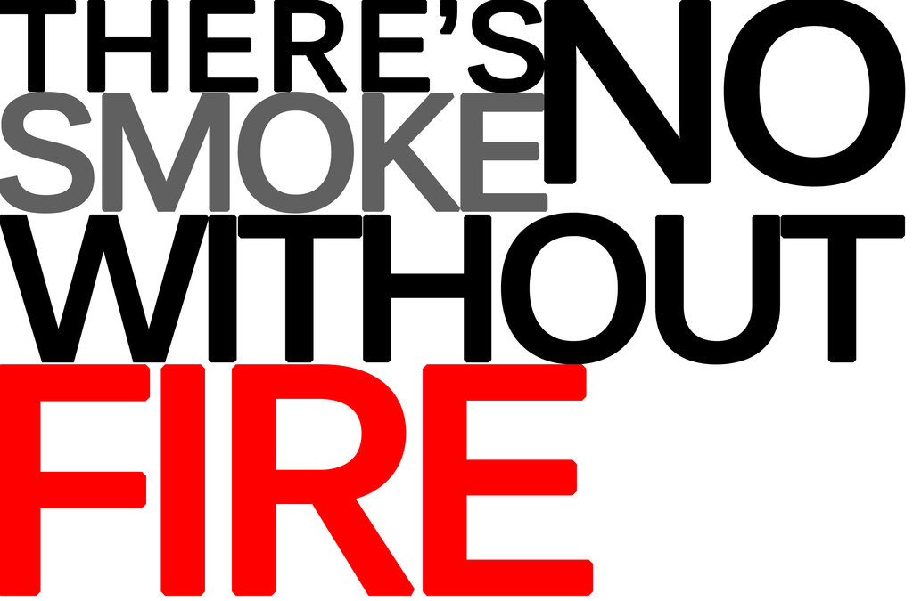
Sometimes Christians misunderstand their calling
Sometimes beliefs that start as healthy become unhealthily misunderstood
Which questions is it important to get right?

Slide 31
Questions
If someone who is not walking with Jesus watched people from Moody church, how might they critique the people they saw going to church?
What negative perceptions do you have of things that go on in churches that you do not attend (Baptists, charismatics, Methodists, Episcopals, etc.)?

Slide 32

Questions To Diagnose Health
What do you value the most?
What books, people, or electronic media inform your life?
Do you believe that human beings are good, evil, or neither?
Is there such a thing as truth?
What, if anything, happens to people when they die?
Is there a physical world, a spirit world, or neither?
Is there a supreme force, power, or being? Can you describe your idea?
Is logic to be trusted?

Slide 33
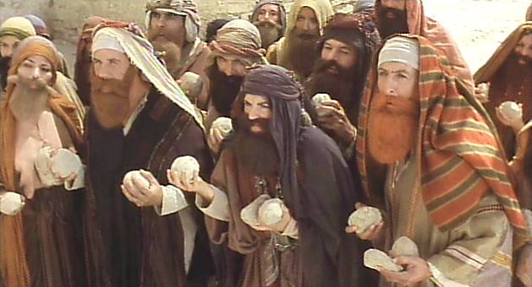
Stone the Christian
Open forum
Try and generate hard questions for Christians

